Slide 1

#isitnormal
Athulya Saiprakash, Elizabeth Zhu, Emiliana Myftari, Lisa Lam & Thomas Turnbull
Notes:
thomas

Slide 2
OVERVIEW

Slide 3
How does today’s weather compare to the historical normal?

Slide 4
IDEATION

Slide 5
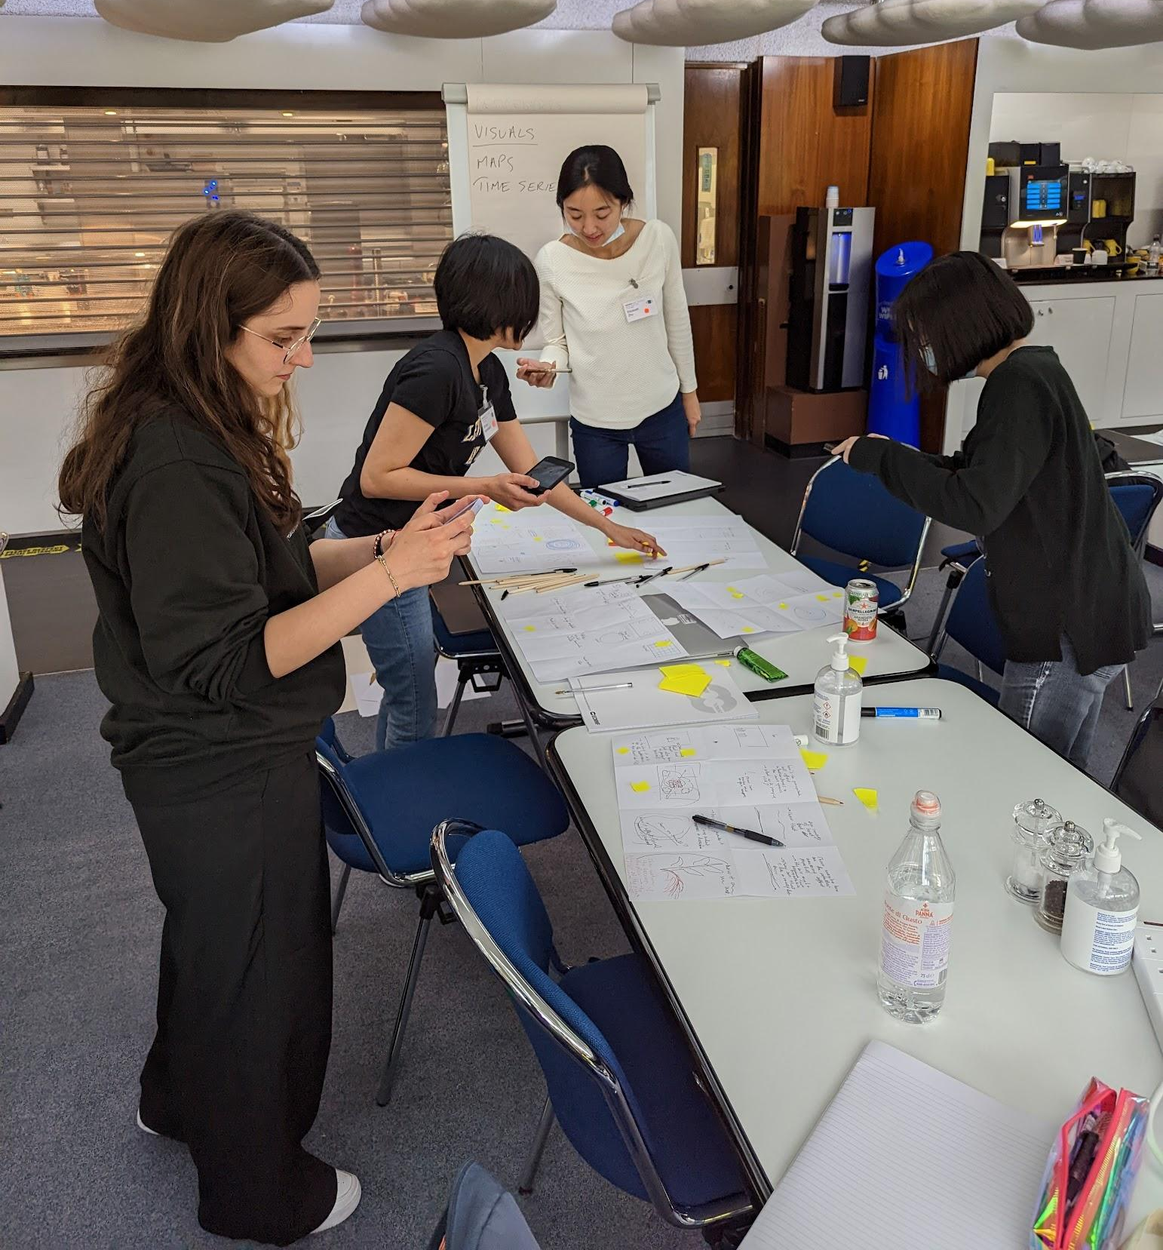

Slide 6
Crazy eights

Slide 7
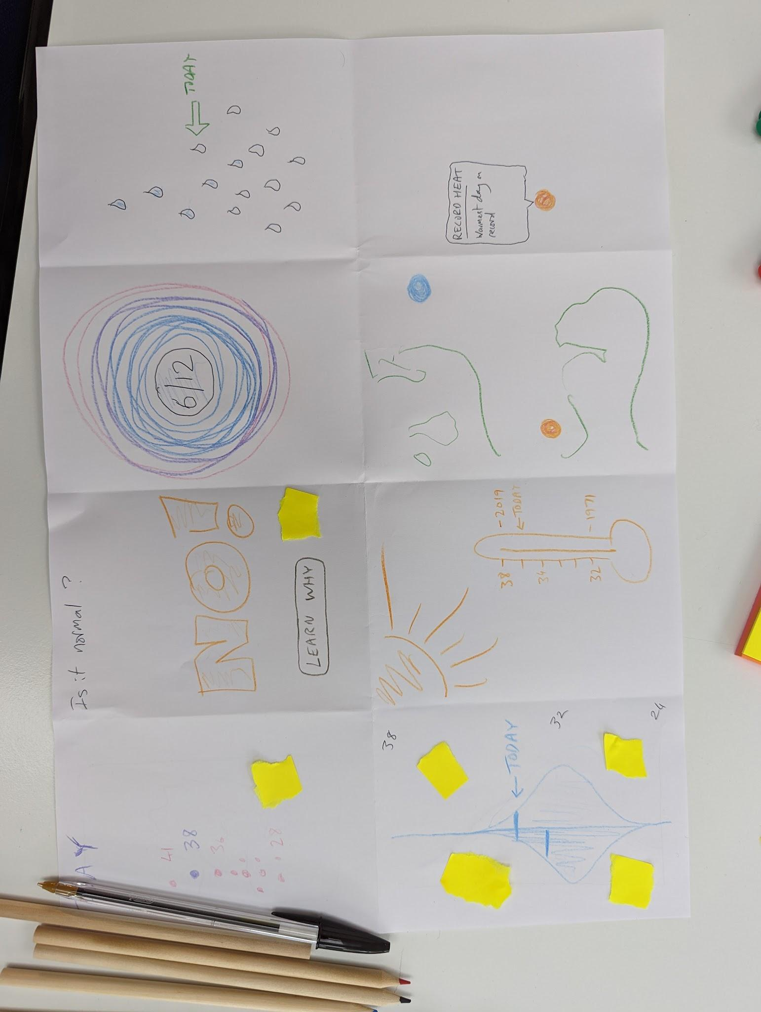

Slide 8
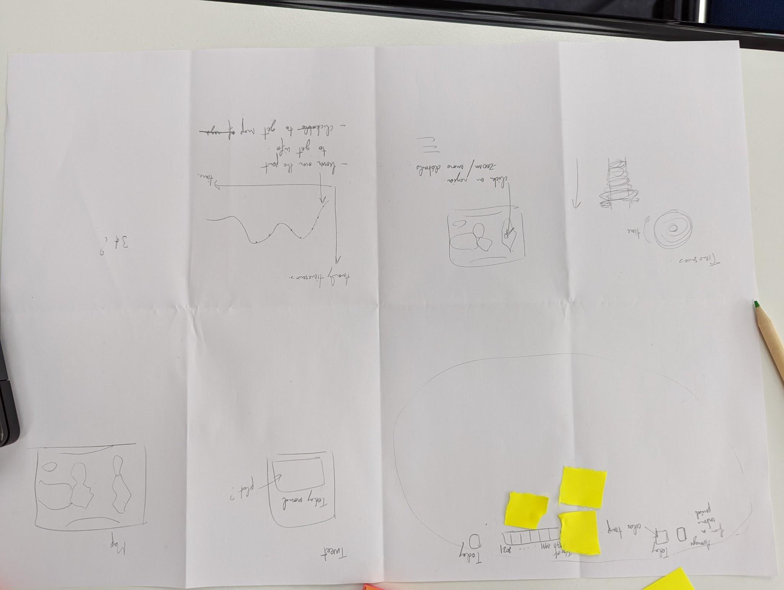

Slide 9
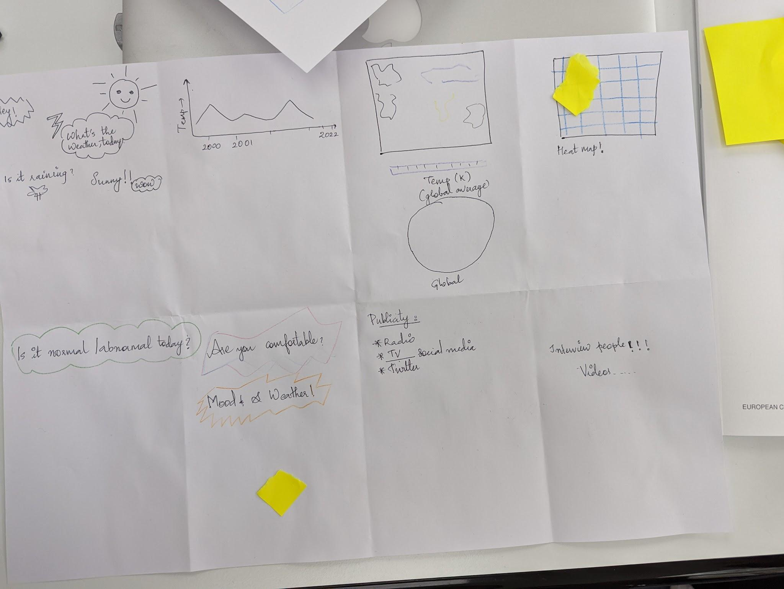

Slide 10
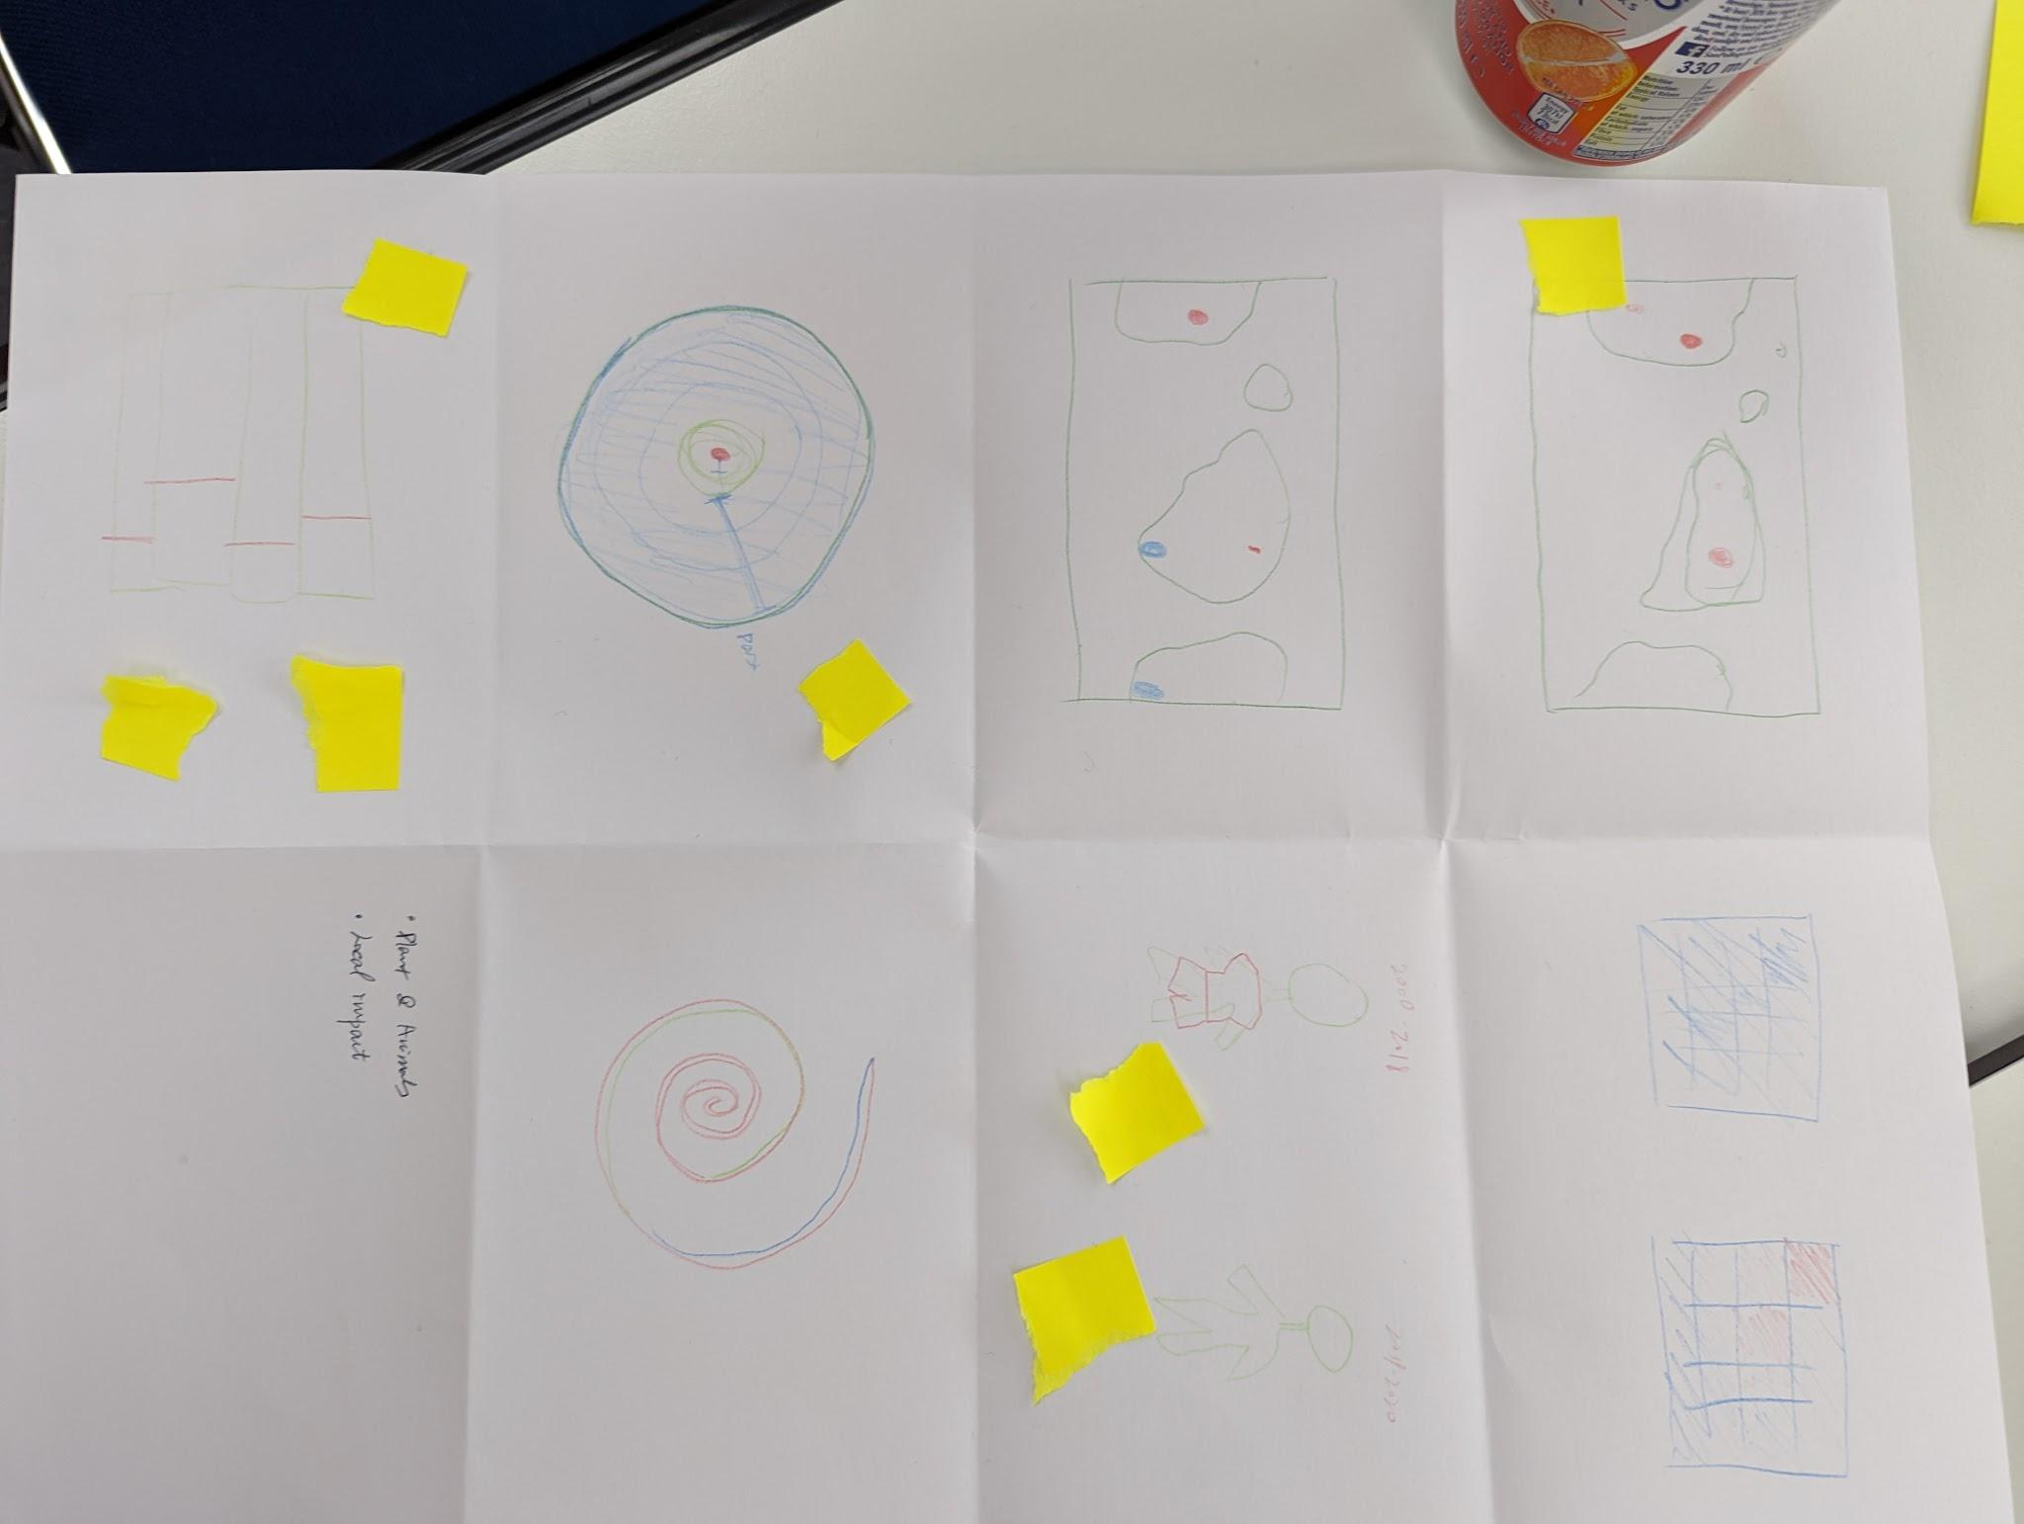

Slide 11
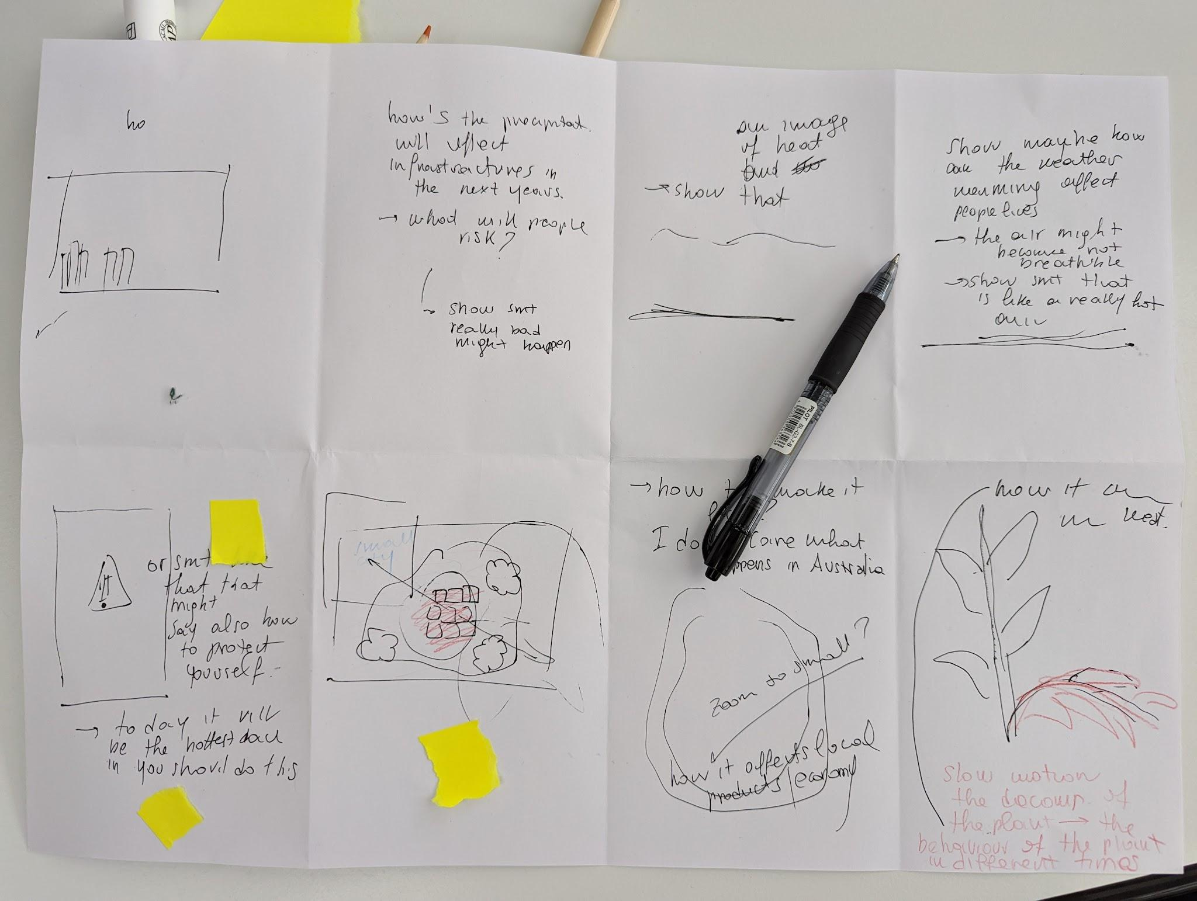

Slide 12
Short-listed concepts

Slide 17
ITERATION

Slide 18
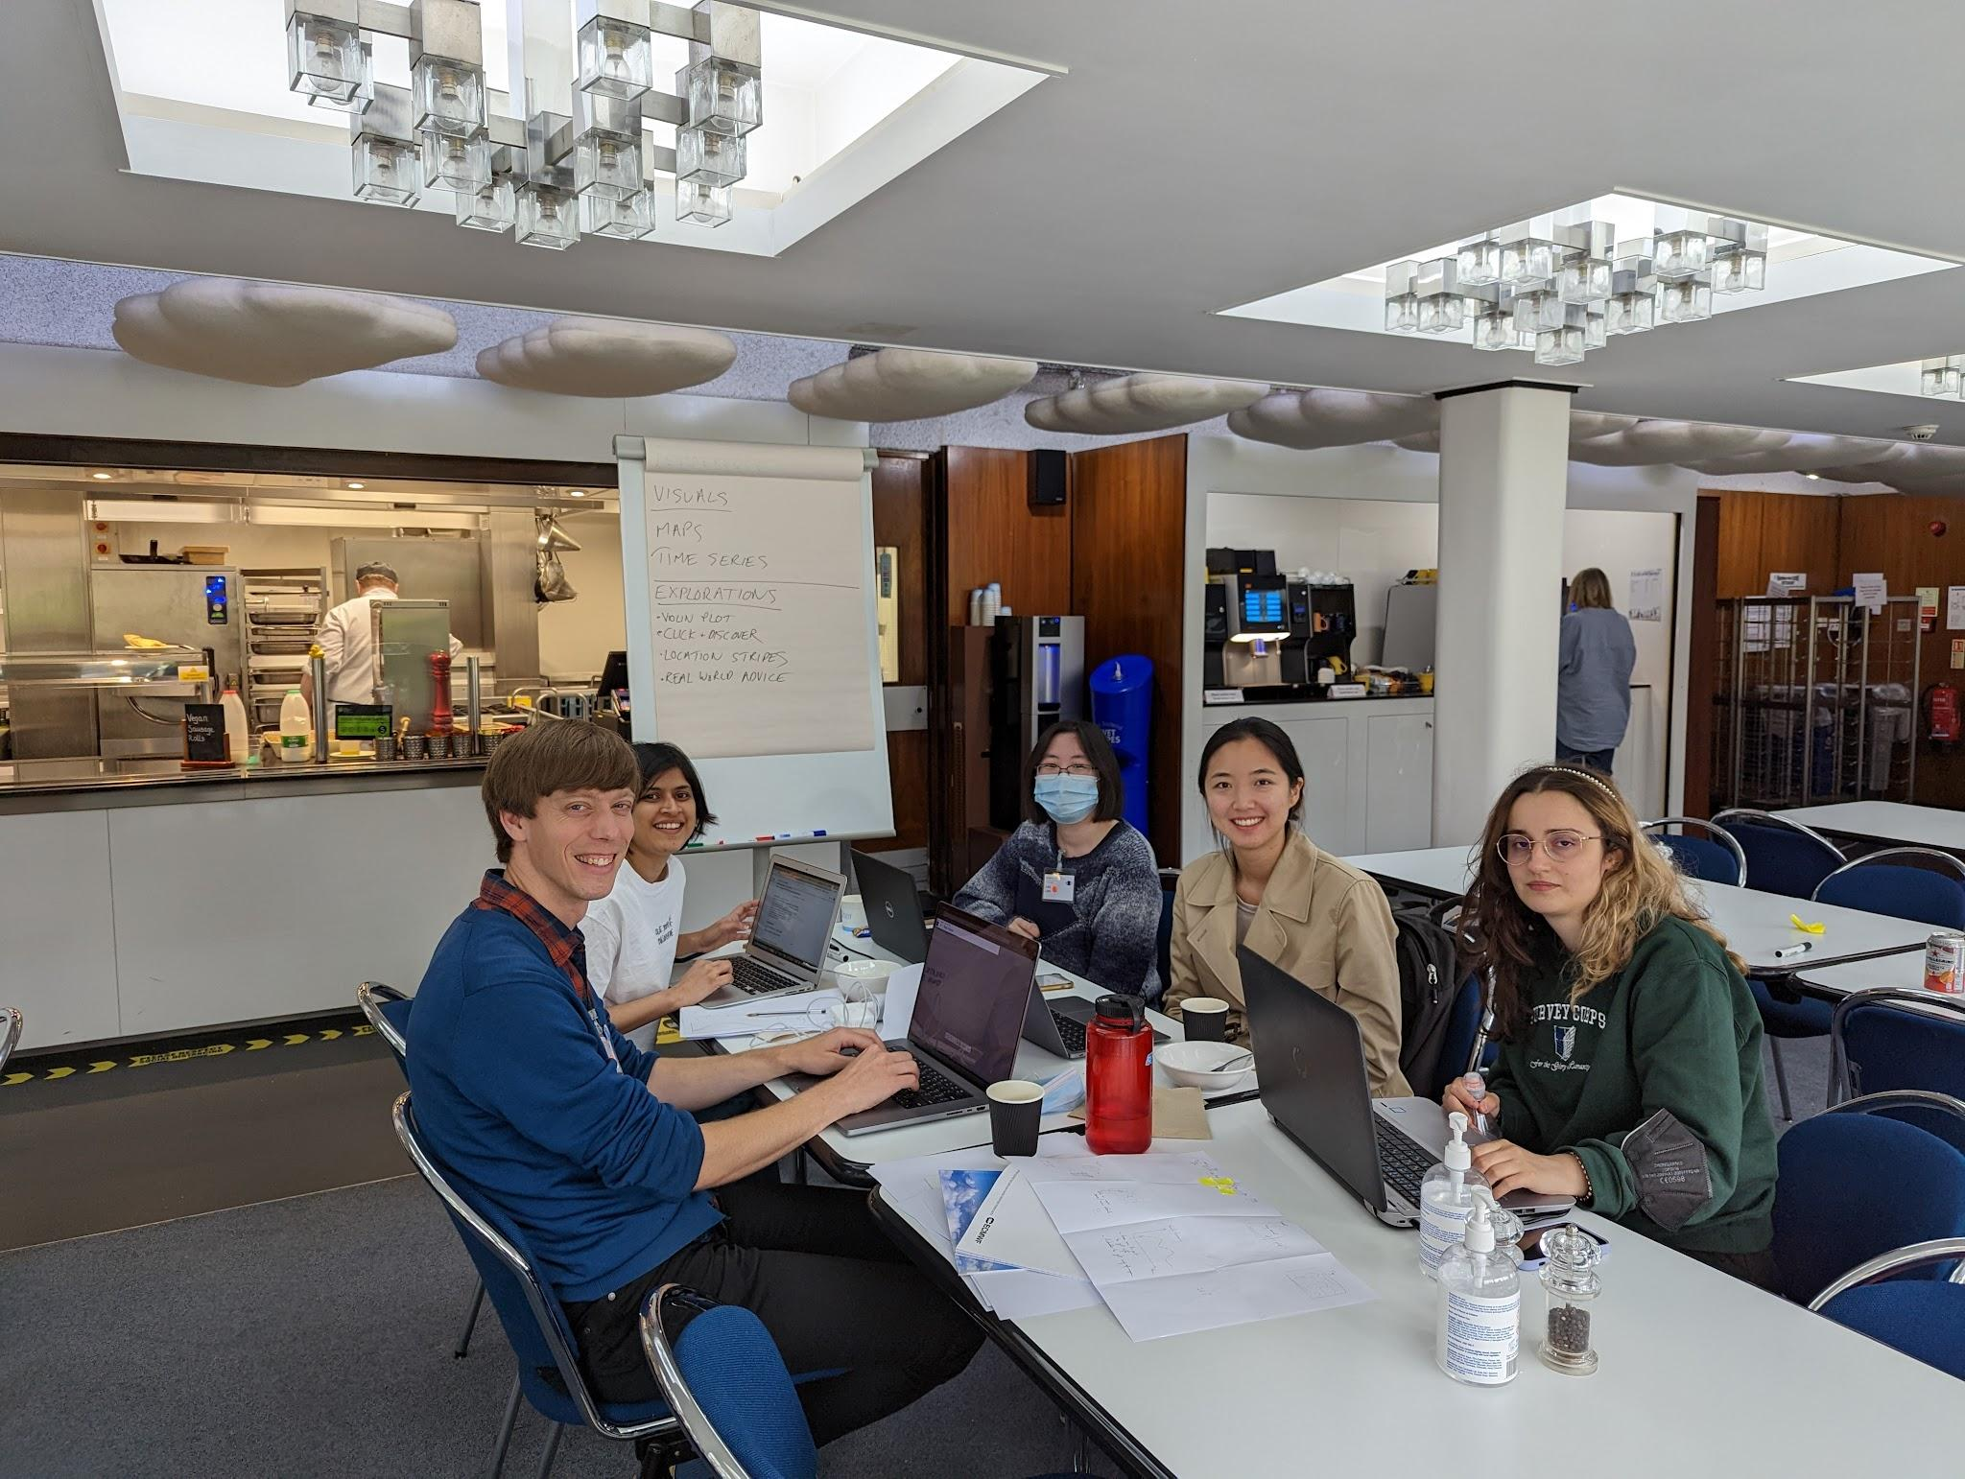

Slide 19
Data
2m temperature
ERA5 hourly data on single levels from 1979 to present
ERA5 monthly averaged data on single levels from 1979 to present
Netcdf format
April 1979-2022 -> validated data mixed with non-validated (yet!) data
Case Studies
Interesting regions
Prayagraj (extreme heat)
Paris, Bologna, NYC, Reading
Temperature as proof of concept
Notes:
Lisa

Slide 20
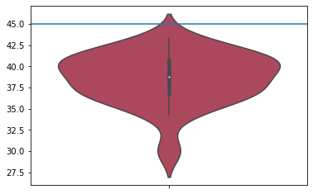

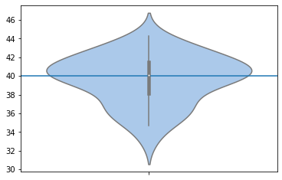
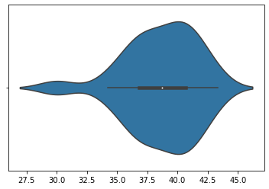
Notes:
Emiliana

Slide 21
Notes:
Thomas
All red didn’t work as well

Slide 22
Notes:
Comparing this day to the same day each year was noisy - hard to see a trend

Slide 23
Notes:
For areas with less variation the colors were too intense

Slide 24
SOLUTION

Slide 25
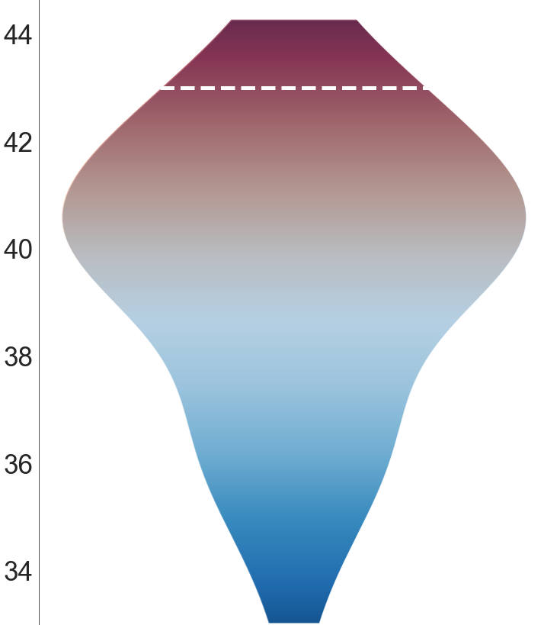
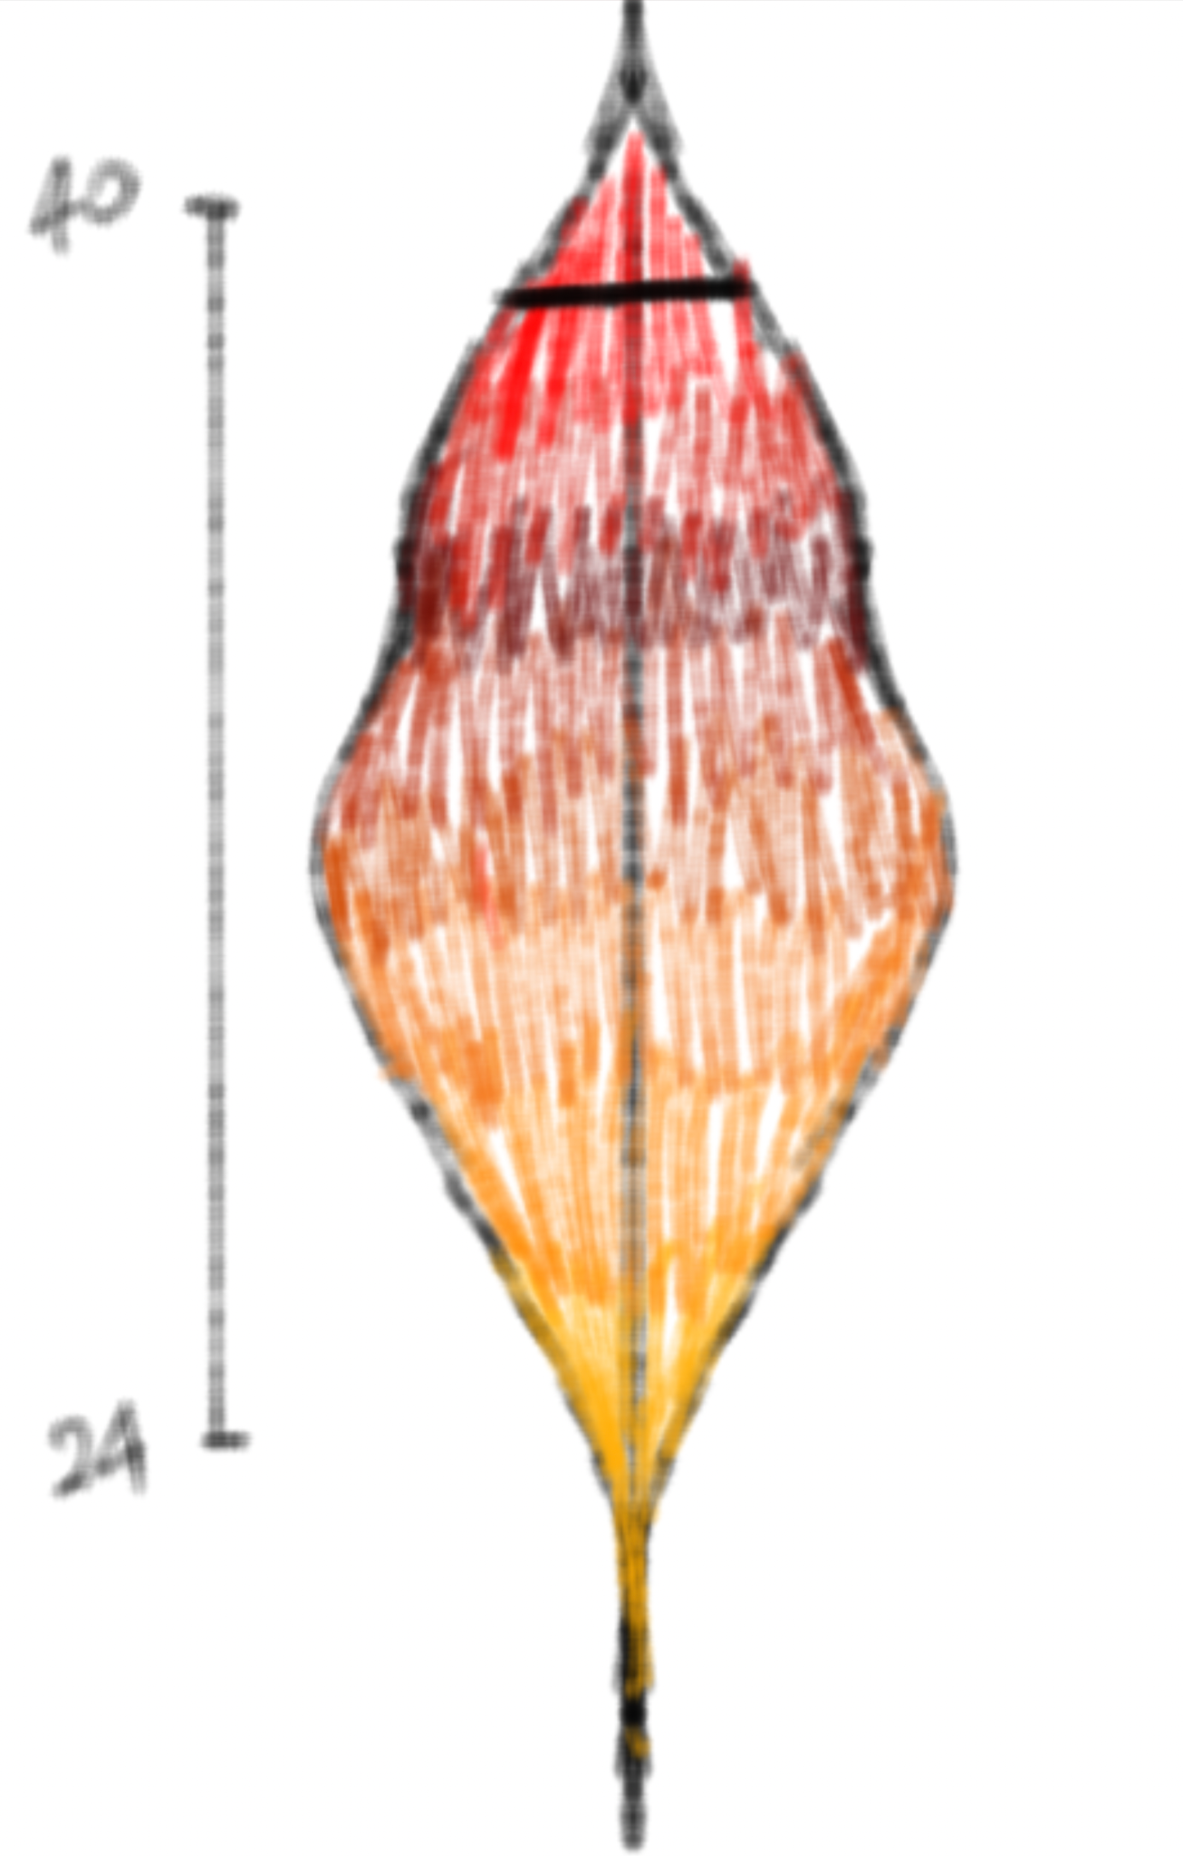
📍Prayagraj
April 27th 1979-2022
Notes:
Athulya

Slide 26
Notes:
Thomas

Slide 31
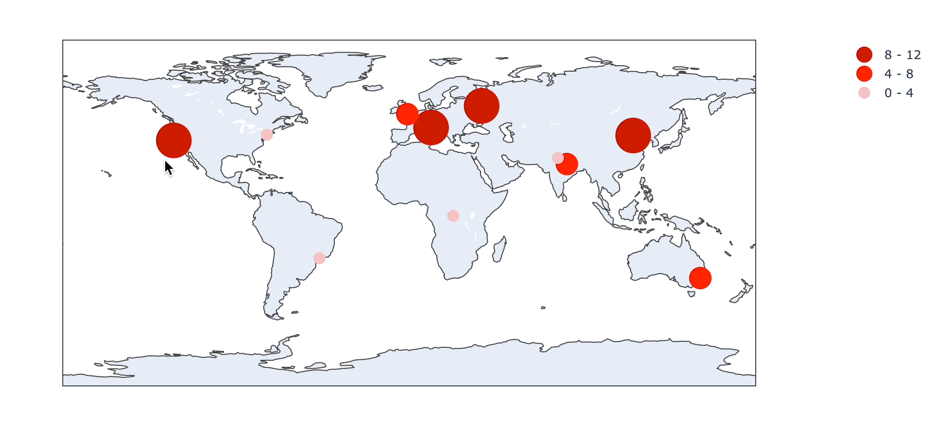
Last Three Years vs Last 20 Years
Notes:
Elizabeth

Slide 32
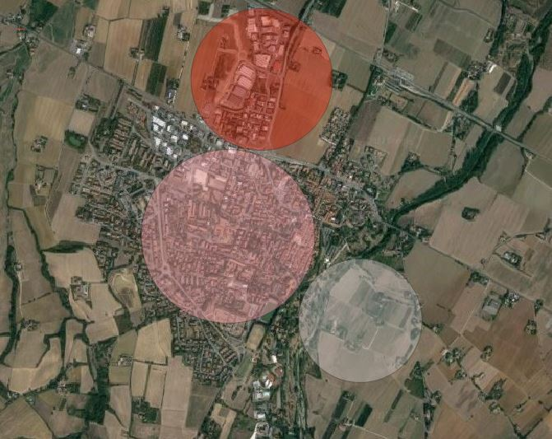
Notes:
Emiliana

Slide 33
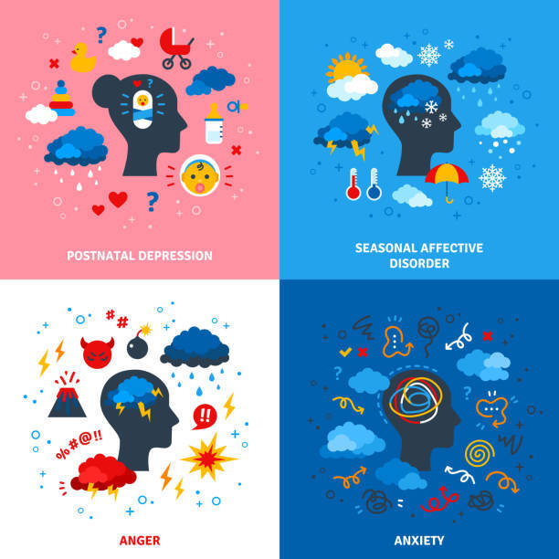
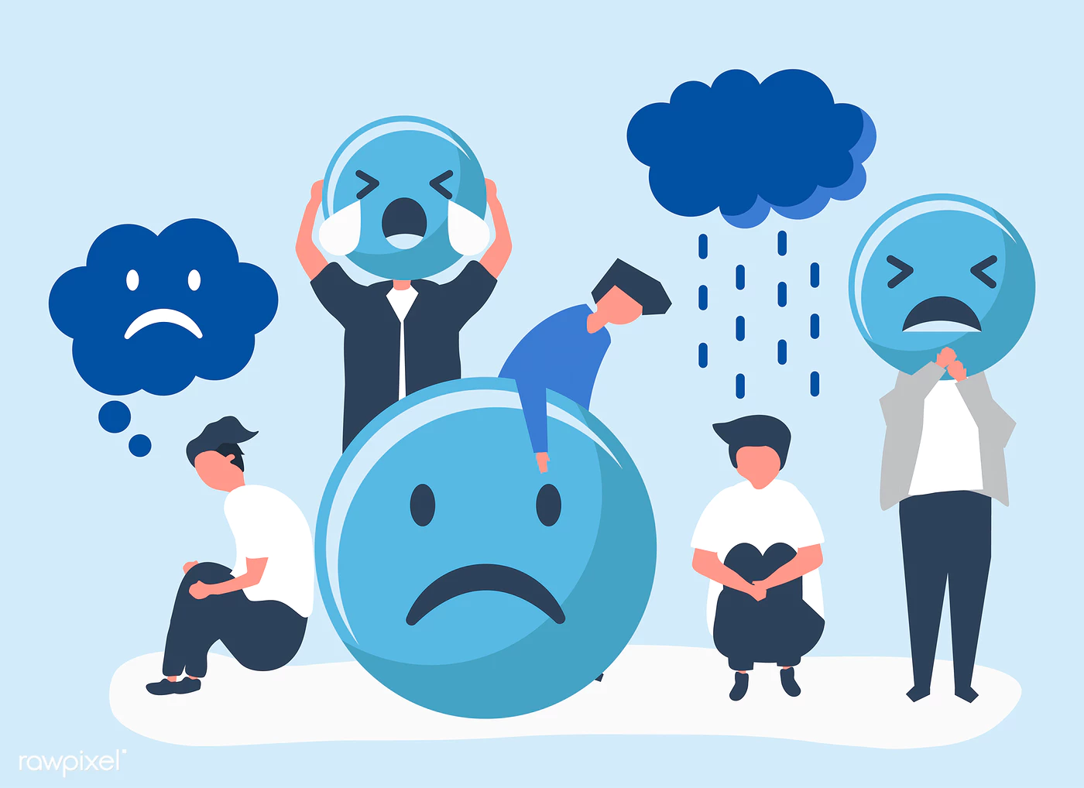
Does weather affect your mood?
Eat a balanced diet
Hydrate
Exercise (and sleep well)
Do what you like to do!
Get out and socialize
Learn something new!
Seek medical help, if necessary!!
Notes:
Athulya

Slide 34
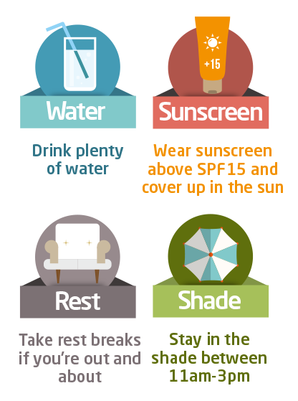
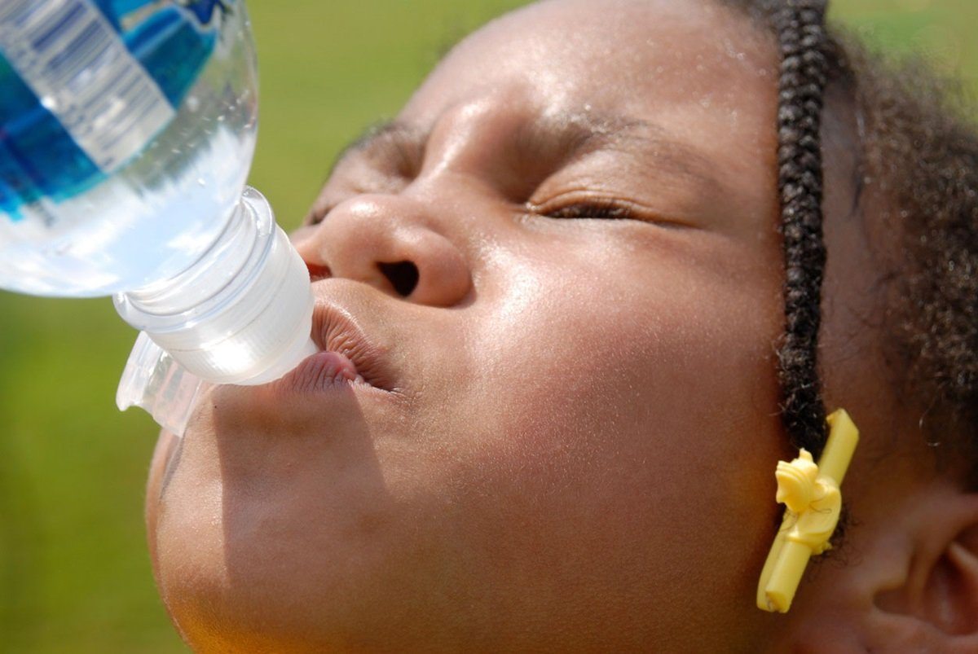
It’s a hot day…
Wear light coloured clothes
Drink water
Avoid heavy food - eat fruits and vegetables
…
Notes:
Emiliana

Slide 35
Thanks!

